Slide 1


.
Notes:
Good morning, everyone. Let's think about Instagram for a moment.
With over 95 million photos posted every day, it’s becoming a habit of how we share our lives.
I remember my first post back in 2019—a picture of cherry blossoms. It was a beautiful moment, I want to capture and celebrate with friends before graduation
(Brief pause)
Now, let’s be honest: we don’t always just follow close friends or celebrities. Sometimes, we find ourselves checking out people that we don’t follow, just to stay in the loop—
One, quick question—who do you follow? Any celebrities or accounts you check regularly?

Slide 2
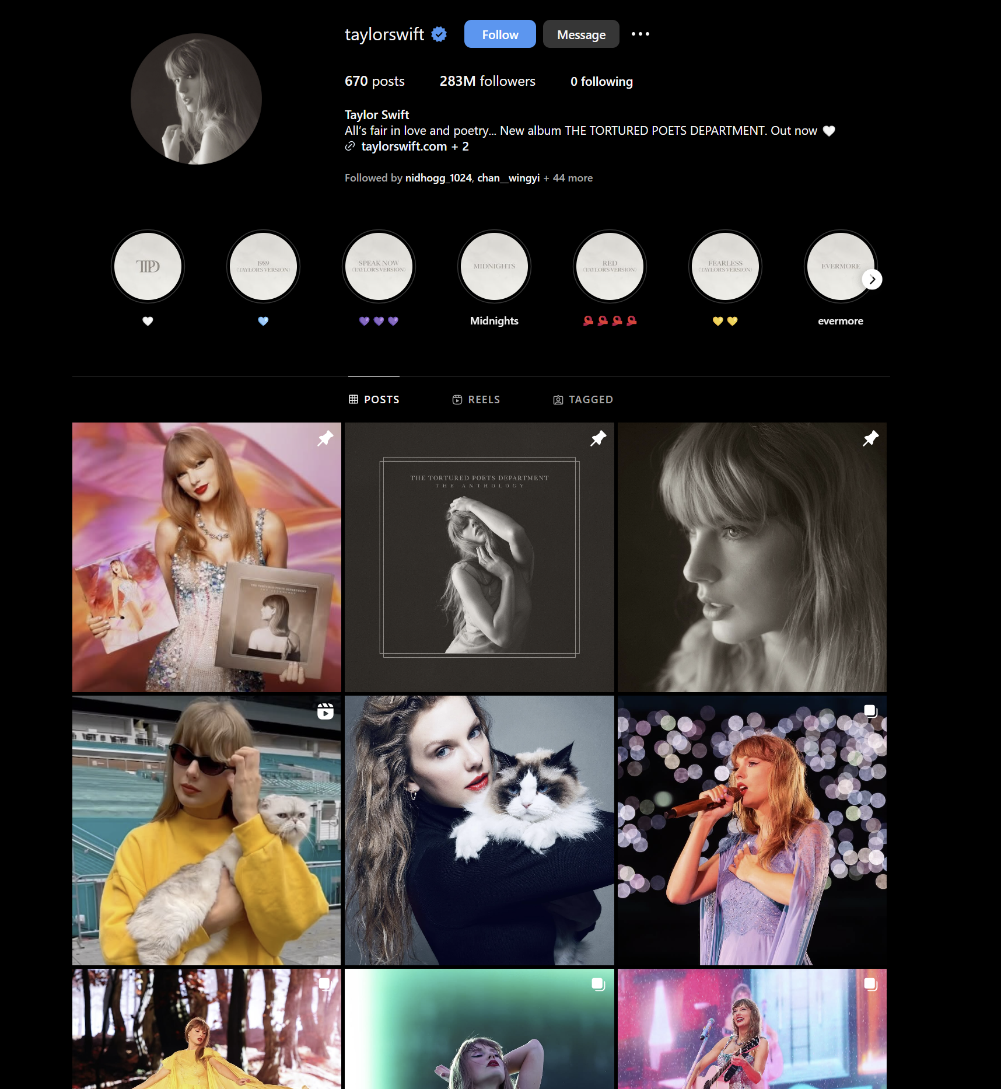
Notes:
I want to use Taylor Swift as our exmaple. For Taylor, Instagram isn’t just a photo album; it's a platform to connect with millions of fans and promote her concerts.
Now, why am I showing this? Well, The dataLAB need something similar—we want the engagement and interactions! But how could we do that?

Slide 3


GitHub: The Instagram for DataLab
Discover how GitHub can revolutionize our data work, just like Instagram changed photo sharing
By IEU DataLab - ON KI Wong
Notes:
And that’s why today, I’m introducing GitHub—a platform built for sharing data, code, and methodologies with others. F
or us, evaluators and researchers, GitHub is like Instagram.
Instead of photos, we upload data and analysis. It’s where we showcase our work to the world.
You might ask, "Why GitHub specifically?“

Slide 4

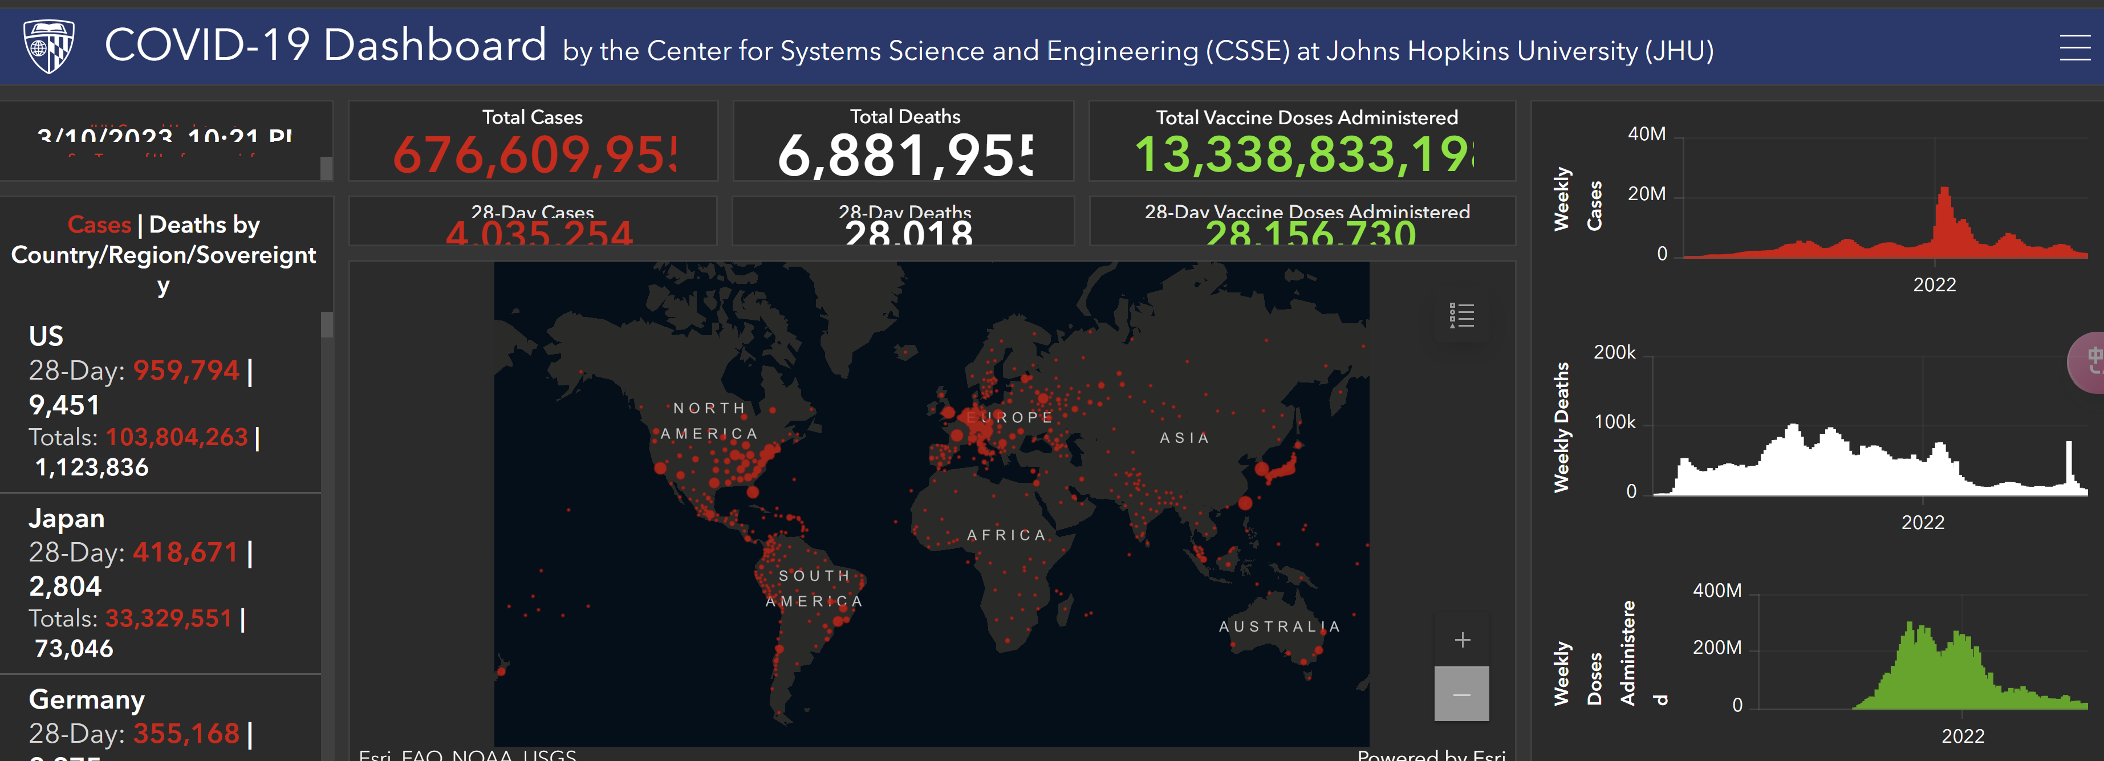
NASA
Academia
Notes:
We have two real-world examples explain it well: NASA and the COVID 19 dashboard.
NASA uses GitHub to share with public their satellite imagery data and complex al.go.ri.thms to migitate mis-calculation in radar beam.
Johns Hopkins, on the other hand, launched its COVID-19 dashboard using GitHub.
Many of you have seen it in action, providing real-time data globally.
In fact, during my time at the World Food Programme, we used their API to estimate how many children lost access to school meals during the lockdowns.
These …organizations didn’t pick GitHub randomly. They chose it for reliability, transparency, and its ability to foster collaboration.

Slide 5
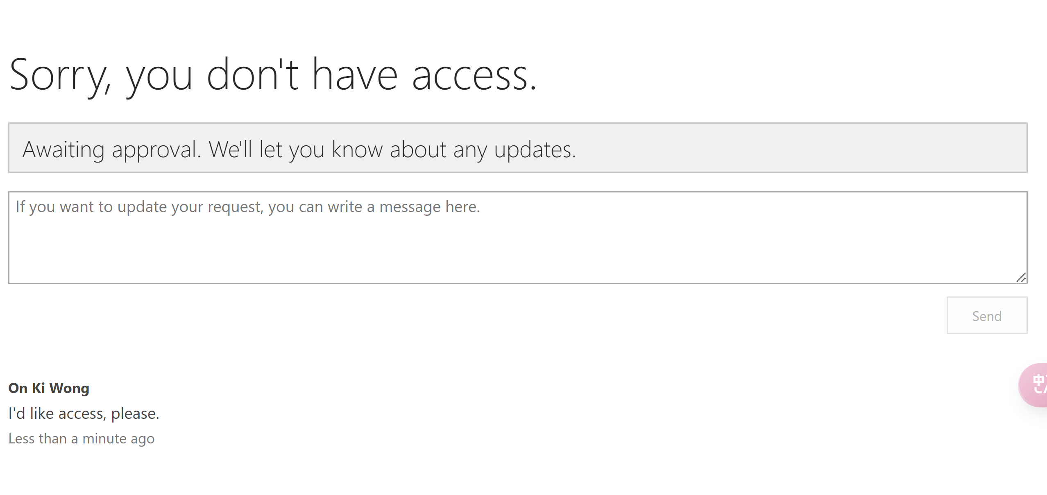


IEU's Challenges
Access to SharePoint
Ideally, all files are accessible &organized.
Notes:
Coming back to our current situation.
Genta/Elang, do you remember when was the last time we all lost access to a SharePoint folder?
It's a real pain, isn’t it? You’re right in the middle of something important, and boom—everything grinds to a halt. Progress frozen. We’ve been there.
Unreliability—SharePoint often becomes inaccessible, stopping our work.
I’m sure everyone here knows the frustration.—it’s affecting our timelines and productivity.

Slide 6


Version Control
We want to always know which document version
is latest
Notes:
On my second point, sometimes it feels like our data is mesey like a children's playroom—files here, versions there. And when it comes to version control, it’s a nightmare.
Here’s the second problem: We can’t always tell which file or analysis is the most current.
And when it’s time to share with external stakeholders? It’s a chaos. It’s tough to track, and it wastes time and energy, and often leads to mistakes.

Slide 7


Tracking contributors
Work together seamlessly on projects.
Notes:
Lastly, and maybe most critically, tracking contributors has become almost impossible. Who made what change?
Where’s the feedback? And how do we ensure everything is reproducible? We need a system where each contributor’s work is automatically recorded, feedback is transparent, and anyone can retrace the steps.
Right now, it's like trying to finish a puzzle with missing pieces.

Slide 8
Traceability
Optimization Reliability
Notes:
GitHub addresses these exact challenges through what I call 'TOR’:
Traceability, Optimization, and Reliability.
Where Every contribution is tracked—who did what and when—so no confusion.
Secondly. Team collaboration becomes seamless—no more messy versions.
Thriedly, Unlike SharePoint, GitHub is stable and secure.
In short, GitHub keeps our work organized, accessible, and accountable, ensuring nothing is lost or unorganized

Slide 9

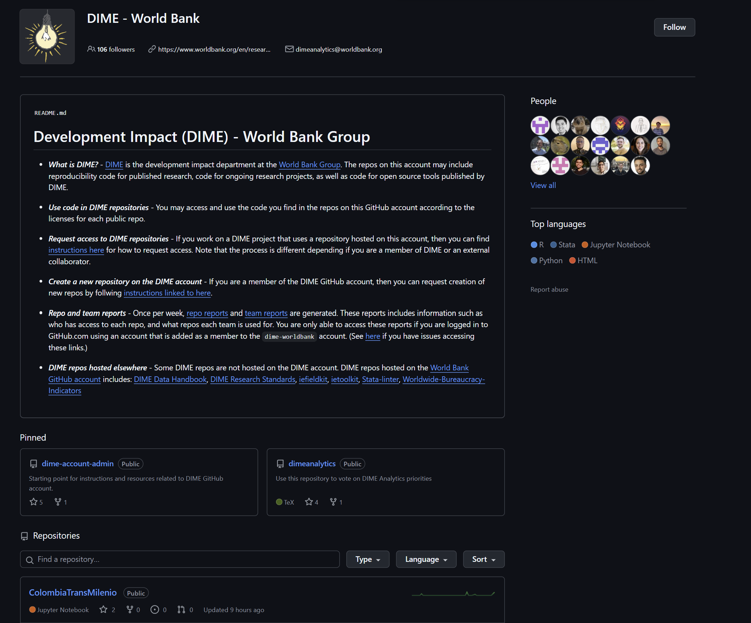
1
Instagram Likes
Get validation for your latest selfie.
2
GitHub Forks
Receive credit for your hard work.
3
Collaboration
Build on each other's work and ideas.
Notes:
Now, let’s take a look at a strong example—World Bank’s DIME unit.
They use GitHub to host all of their reproducibility packages, including datasets, scripts, and documentation.
This makes their work fully transparent and accessible to public.
Currently, at IEU, our website works well for sharing reports, but it lacks the functionality for real-time data engagement.
With GitHub, not only can we store our analysis, but we can also track who's using it and how, giving us much-needed impact insights.

Slide 10
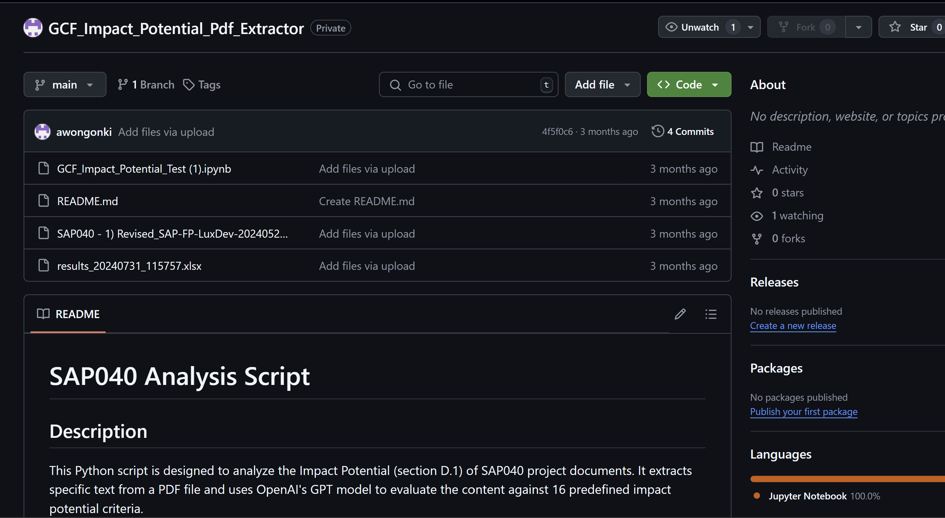
1
Instagram Likes
Get validation for your latest selfie.
2
GitHub Forks
Receive credit for your hard work.
3
Collaboration
Build on each other's work and ideas.
Notes:
Let me show you a practical example I worked on earlier this year.
I built a Python script to extract key information directly from PDFs to automatically populate indicator questions. It was a significant time-saver for updating the impact potential dataset.
Now, this repository is set to private, aligning with GCF’s strict data-sharing policies.
If we all agree on moving forward with GitHub, I propose we pilot this with the LAC evaluation project—pending green light from management and ICT approval."

Slide 11

Case study - Handling High-Stakes Inquiries
You are representing IEU at a conference…..
A researcher from a prominent think tank approaches you.……
However, they need to understand how we calculated critical data—
Notes:
Consider this situation: You are representing IEU at a thematic conference. During a break, a researcher from a prominent think tank approaches you. They express interest in citing IEU's analysis in their upcoming publication. However, they need to understand how we calculated critical data—such as the AEs' approval dates, the investment score for a specific region, or the criteria we used to classify Indigenous Peoples in our report.“
"Your colleague, who led this analysis, is not present. Furthermore, the methodology and calculations behind the charts they are asking about are not fresh in your mind."
With GitHub, you have a straightforward answer. Instead of scrambling for emails or scheduling follow-ups, you can provide immediate access to the repository for that evaluation. The repository contains everything—methodologies, formulas, calculations, and the set of keywords used for Indigenous classification. This transparency saves time, avoids miscommunication, and positions IEU as a leader in open, accountable research.
Brief pause.

Slide 12

Notes:
At this point, I’ve walked you through how GitHub can bring significant improvements to the way we manage, share, and protect our evaluation work. But the question I want to leave with all of you today is: What do you think? Take a moment to reflect on what you’ve seen—does this platform align with the needs and challenges we’ve discussed?
Pause to give them a moment to think.
With management approval, I propose using GitHub as a pilot platform, we could decide on the pilot evaluation - starting with the LAC evaluation repository. We can also hold technical sessions to ensure everyone is equipped to leverage this tool.

